Slide 1

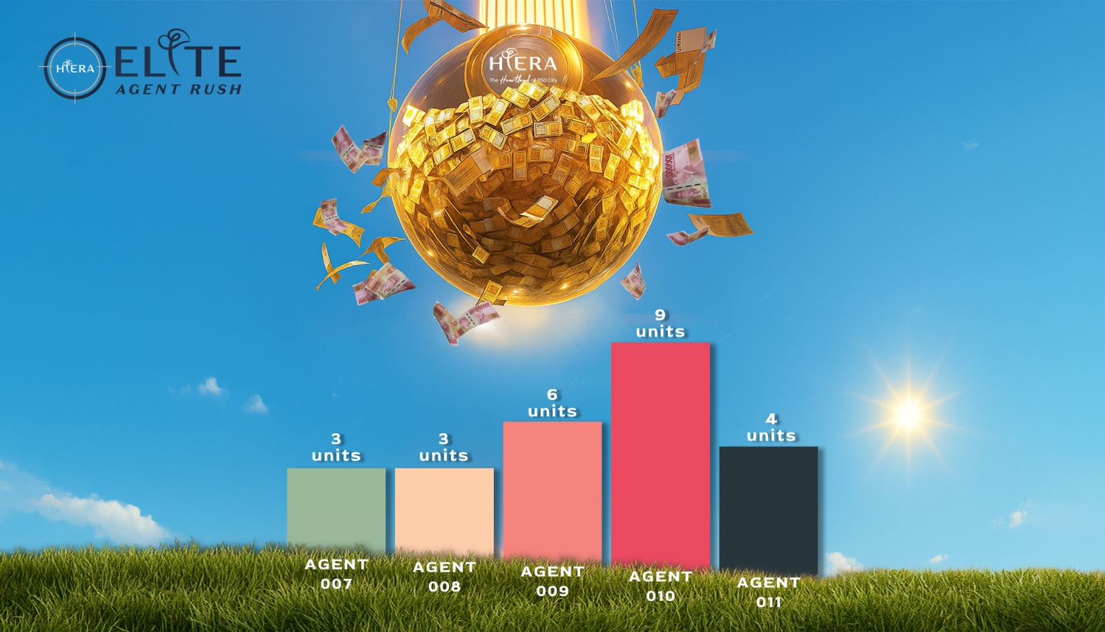







WINNER!!
8 UNITS
7 UNITS
6 UNITS
4 UNITS
3 UNITS
2 UNITS
1 UNITS
www.hierabsd.co.id

